Slide 1
Sentosa’s Insects Data taken from iNaturalist
Considerations when data cleaning
Only records from 01-01-2005 onwards
Not in captivity
Coordinates fall within Sentosa’s/Singapore’s borders, i.e. not in the sea
Subspecies disregarded; observations are merged based on species
55899 records initially, but after cleaning:
 | Sentosa
No. of records | 582
No. of orders | 7
No. of species | 139

Slide 2
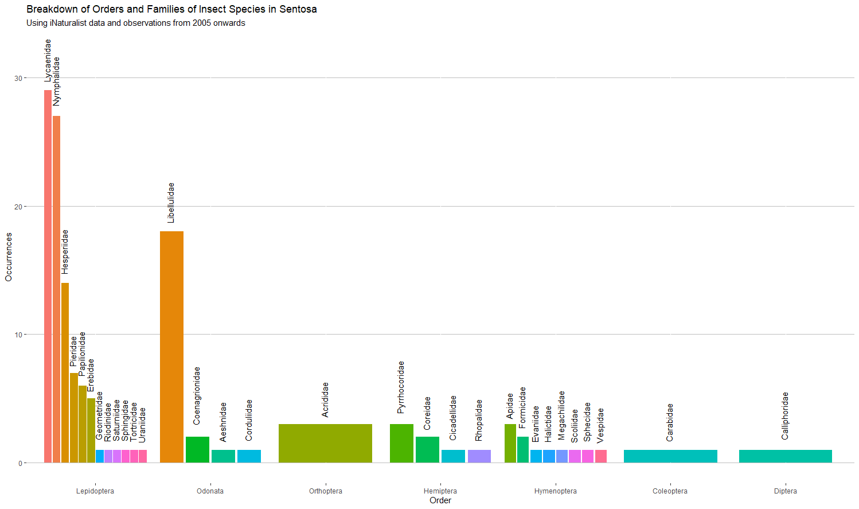

Slide 3
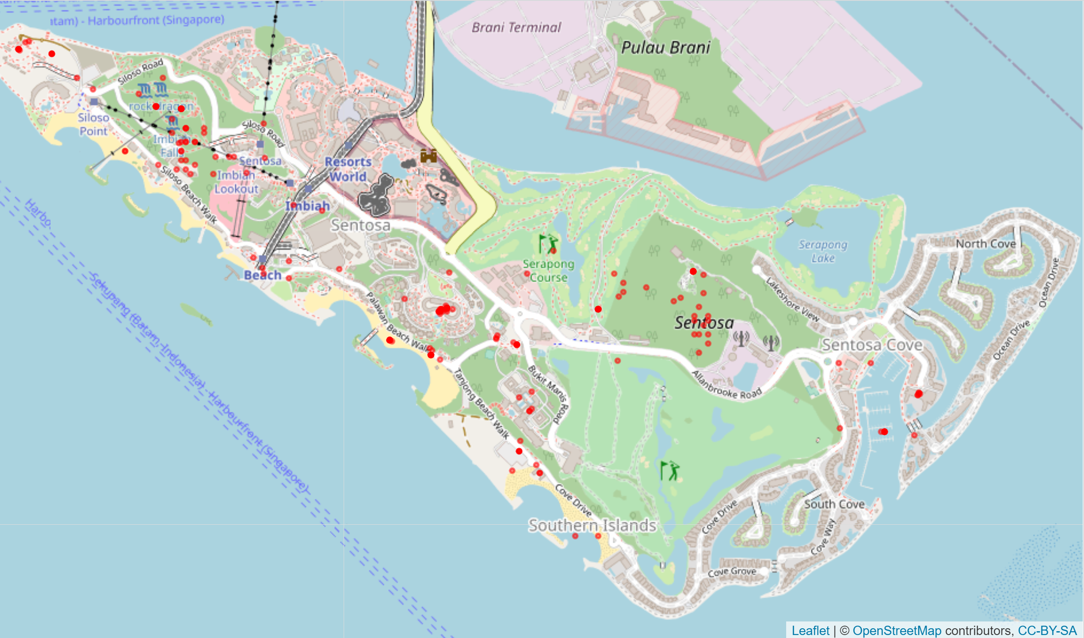
Lepidoptera
Background map taken on 12 Dec 2019, 7.30am

Slide 4
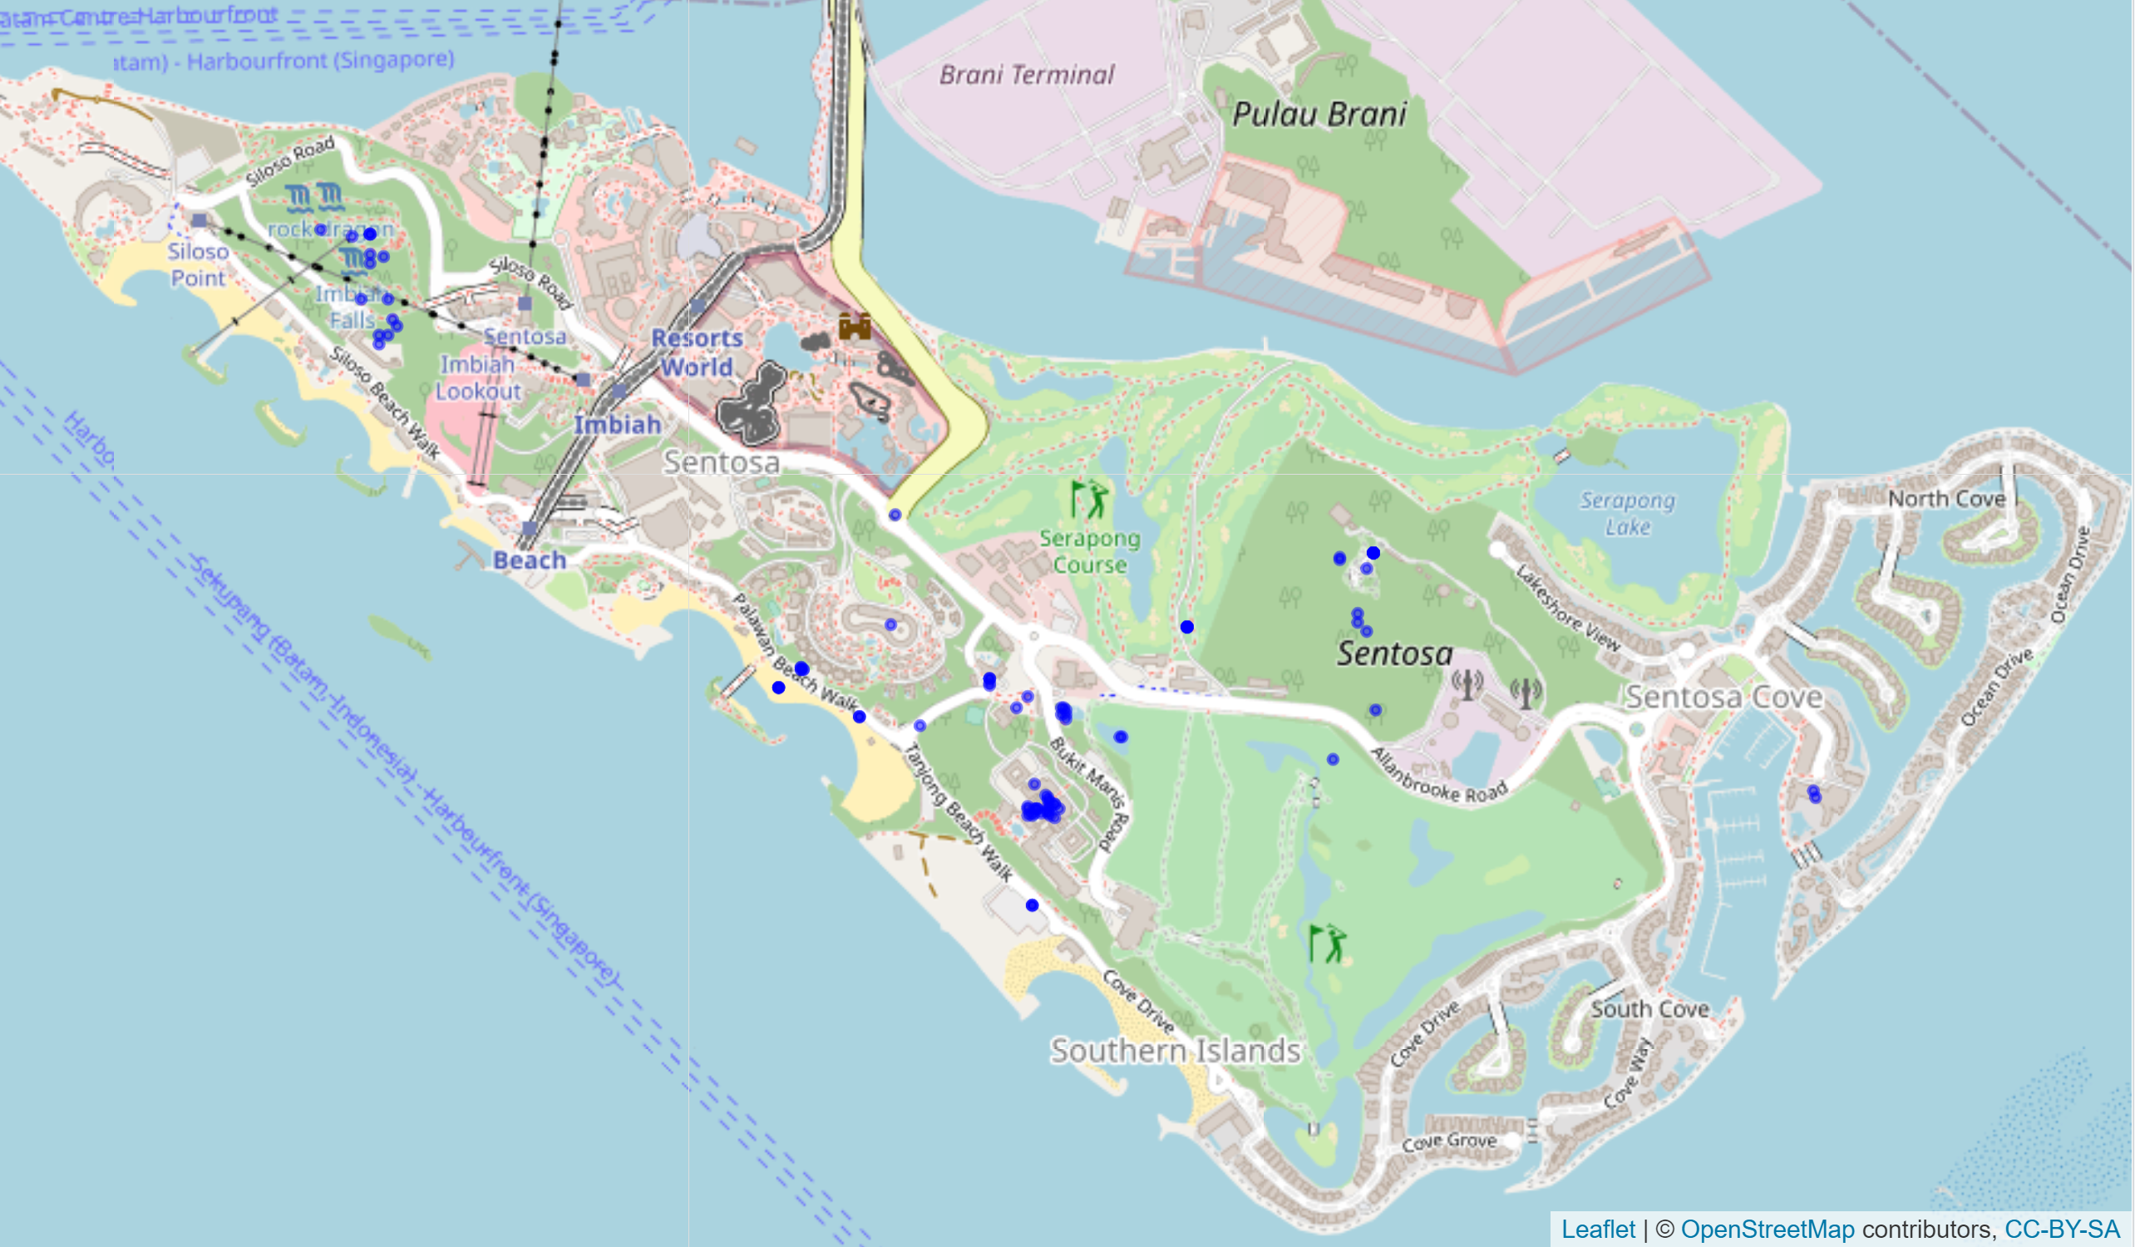
Odonata
Background map taken on 12 Dec 2019, 7.30am

Slide 5
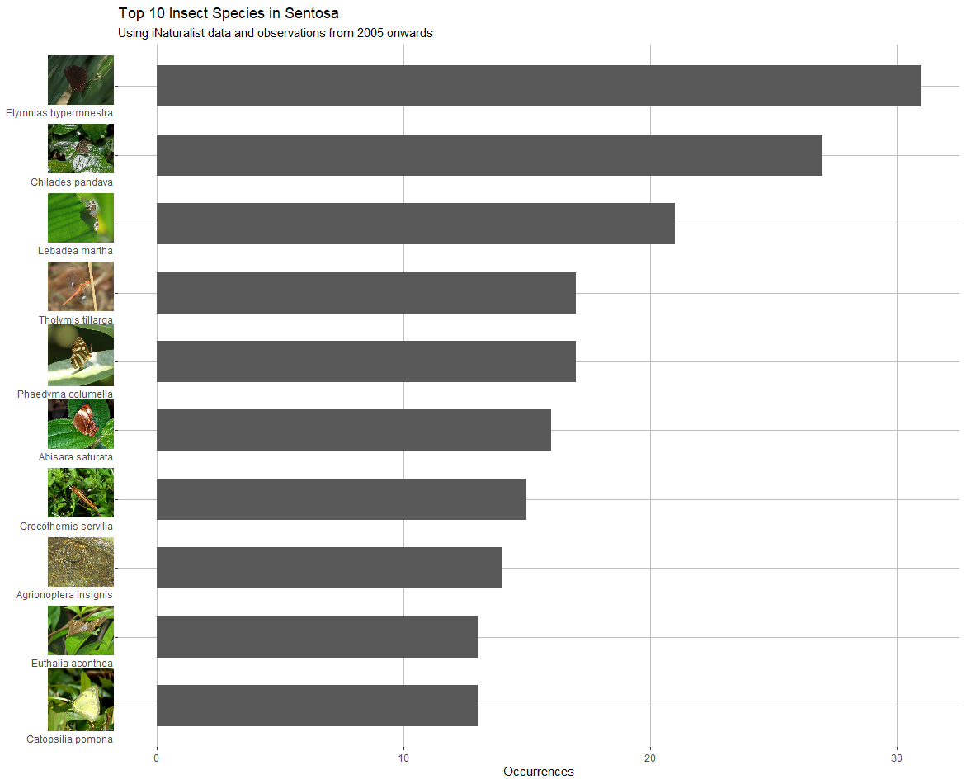

Slide 6
References
Data sources
DIVA-GIS https://www.diva-gis.org/gdata
iNaturalist https://www.inaturalist.org/observations accessed on 31 May 2021 with the query quality_grade=research&identifications=any&iconic_taxa%5B%5D=Insecta&place_id=6734
NCBI Taxonomy Database https://www.ncbi.nlm.nih.gov/taxonomy
Image sources
Image of Elymnias hypermnestra taken by big-simonchan at https://www.inaturalist.org/observations/8425017
Image of Chilades pandava taken by big-simonchan at https://www.inaturalist.org/observations/8422907
Image of Lebadea martha taken by big-simonchan at https://www.inaturalist.org/observations/8703631
Image of Tholymis tillarga taken by big-simonchan at https://www.inaturalist.org/observations/8788015
Image of Phaedyma columella taken by tiangpee at https://www.inaturalist.org/observations/6085924
Image of Abisara saturata taken by big-simonchan at https://www.inaturalist.org/observations/8598223
Image of Crocothemis servilia taken by big-simonchan at https://www.inaturalist.org/observations/8760116
Image of Agrionoptera insignis taken by big-simonchan at https://www.inaturalist.org/observations/9143736
Image of Euthalia aconthea taken by big-simonchan at https://www.inaturalist.org/observations/8788017
Image of Catopsilia pomona taken by alanowyong at https://www.inaturalist.org/observations/8678939

